Slide 1
Welcome To All
Presentation by: Yashaswi HK
Topic: Cloud Computing

Slide 2
Cloud computing
History of Cloud Computing
The cloud computing first started on 2006
Amazon Web Seriver(AWS) launched the cloud computing
Joseph Carl Robnett Licklider he is father of CC and also called J.C.R.Licklider.

Slide 3
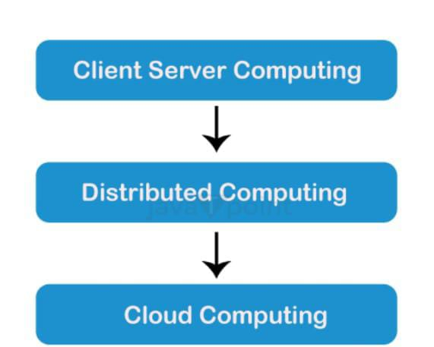
What is cloud computing
Cloud Computing referred as the accessing and storing of data and provide services related to computing over the internet.

Slide 4
Client Server Computing
The server side of this architecture served as the central location for all software programs, data,and controls.
Distributed of Distributed Computing
This model allowed for parallel processing and increased efficiency by dividing tasks across various processors. Multiple computers cloud cooperate and share resources and processing power thanks to distributed computing.
Cloud Computing
Client/server and distributed computing paradigms served as the cornerstones for the paradigm that eventually developed as cloud computing. The goal of cloud computing was to offer consumers flexible, scalable, and economical access to computing resources, storage, and application.

Slide 5
Amazon Web Services(AWS)
The very beginning of AWS was in 2006 when the Amazon Simple Queue Service(Amazon SQS).
This was shortly followed by S3, EC2, and with these first offering made by AWS.
The foundations were being built to push AWS to be a global player in cloud computing.
S3 said Amazon Chief Technology Officer
The name of the first Amazon web services (AWS) services, Amazon S3,begins with that word: simple storage service.

Slide 6
Advantages and Disadvantages(AWS)
Advantages
Ongoing portfolio development
Wide range of capabilities
Easy to use
Extensive Geography
Provide speed and Agility
No capacity limits
Polyglot support
Scalability
Flexibility
Cost-effectiveness
Security
Global reach
Disadvantages
Limitation of Amazon EC2.
Off-radar updates
Technical support fee
High price
General cloud computing issues
Complexity
Need for technical expertise
Cost
Security concerns
Vender lock- in
Potential downtime

Slide 7
THANK YOU
ALL

